Slide 1


The Basics of R Day 2 – Charts & Analysis
An Introduction to the R Programming Language for ADF&G Fishery Biologists
January 2021
Instructor: Justin Priest
https://github.com/justinpriest/R_Intro_ADFG/

Slide 2
Welcome Back!
I’ve incorporated the feedback from Monday’s class: today we’ll focus more on charts and ggplot than analysis.

Slide 3
Today’s Agenda
09:00–11:00 Let’s Make Charts
11:00–12:00 Basic Analysis & Tidyverse
12:00–13:00 Lunch
13:00–14:00 Project
14:00–14:15 Concluding Thoughts

Slide 4
5 – Let’s Make Charts!
Charts and plots and graphs, oh my!

Slide 5
Chart Types
First, decide how to present your data
Are you looking to show:
Trend over time
Composition
Compare / contrast
Distribution
Relationship

Slide 6
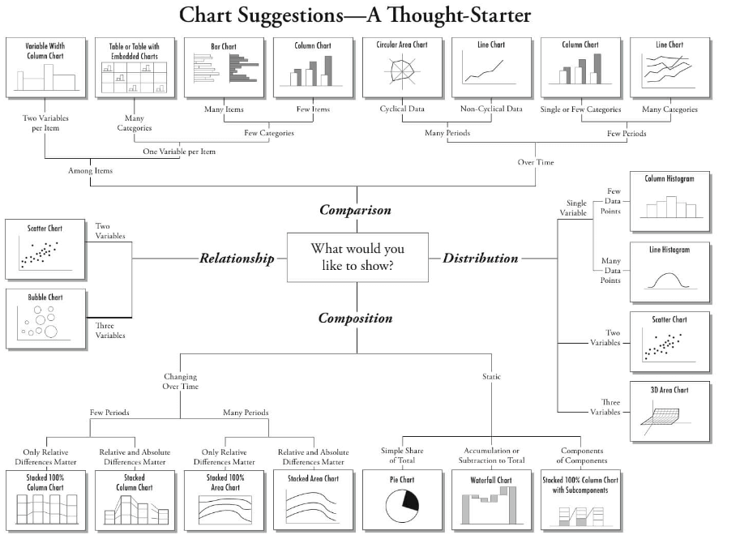
Chart Types

Slide 7
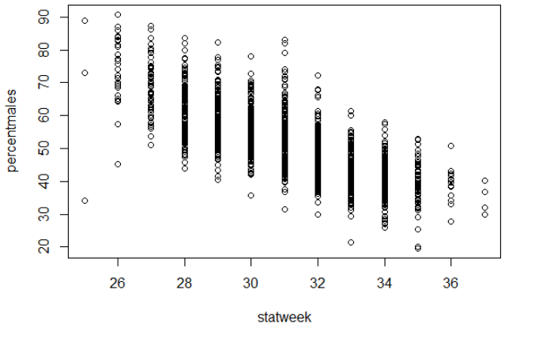
Chart Basics
Use base function plot()
Syntax is plot(yaxiscolumn ~ xaxiscolumn, data = dataname)
Using plot() is very quick and easy!

Slide 8
ggplot2 – A Better Way
We’re getting ahead of ourselves: ggplot2 is part of the “tidyverse” group of packages. We’ll learn more about them later today
Why use ggplot2 over base plot?
Faster to hit ground running
If you make anything beyond basics, it’s easier

Slide 9
ggplot2
Use a “+” to connect between lines
The aes() function is the “aesthetics”. Set which columns are equal to x, y, color, fill, and group.
Add data using “geom_”, e.g., geom_point(), geom_line(), etc
Control aspects of the axes (and other parts) with “scale_”, e.g., scale_y_continuous, scale_x_discrete
Set visual elements using theme()
Establish the plot
> ggplot(data = mydataframe, aes(x = xcolumn, y = ycolumn, group = Year)) +
scale_x_continuous(breaks = c(1990, 2000, 2010, 2020)) +
geom_line()
Control x axis (set axis breaks)
Create lines
Notes:
We build up a ggplot object layer by layer

Slide 10
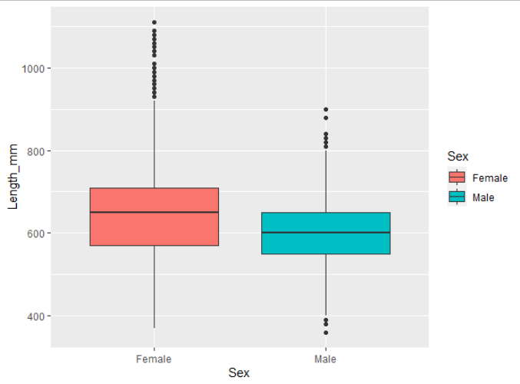
Anatomy of a ggplot
Establish which dataframe to look at
ggplot(data = sablefish,
aes(x=Sex, y = Length_mm,
fill = Sex)) +
geom_boxplot()
“Sex” should be along x-axis, with length on y
Fill the objects based on the Sex column
Two required parts:
ggplot()
geom_xxx()
Create a boxplot!

Slide 11
ggplot parts: ggplot()
Two parts of ggplot(): data and aesthetics
Establish data using data =
Use aesthetics to “map” different variables to the x-axis, y-axis, fill, color, group (series), etc.
Done within the aes() function
Technically, both these parts can happen within the geom_xxx()
ggplot(data = mydataframe, aes(x = xcolumn, y = ycolumn, group = Year))
The aes() function can contain other parts:
shape = variable,
fill = variable,
color = variable,
alpha = variable

Slide 12
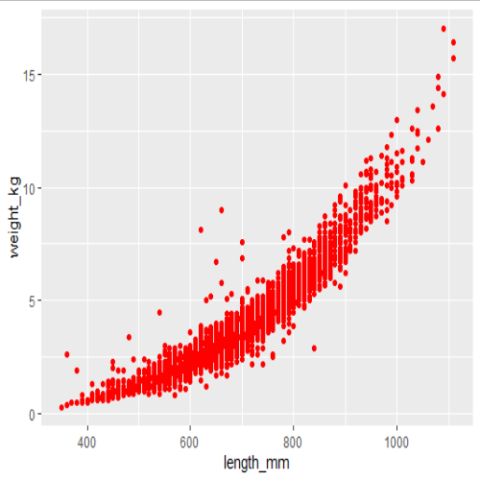
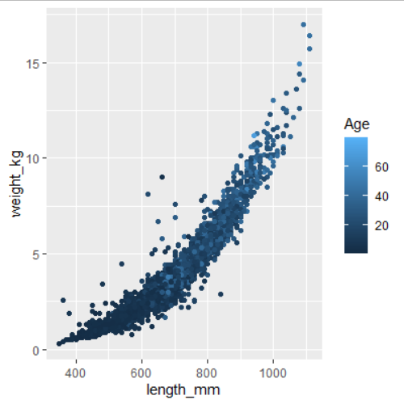
ggplot parts: aes()
It can be tricky to wrap your head around the aes function
Anything dynamic (changes according to a variable) goes INSIDE the aes()
Anything that is static goes OUTSIDE the aes(), in geom
Make sure to keep the aes() inside the ggplot()
ggplot(sablefish, aes(x=length_mm, y = weight_kg)) +
geom_point(color = "red")
ggplot(sablefish, aes(x=length_mm, y = weight_kg, color = Age)) +
geom_point()

Slide 13
ggplot parts: geoms
Tell ggplot what kind of plot you’d like:
geom_line()
geom_point()
geom_col()
geom_text()
geom_boxplot()
geom_histogram()
geom_smooth()
geom_abline()
many more!
Set color line, fill color, size, transparency (alpha), shape, (assuming these are not changing by variable!)
Plot Type & Notes:
Basic line. Typical arguments
Basic scatterplot. Typical arguments
Basic bar (columns). Note that “fill” is the bar color, color is bar outline
Scatterplot but use text instead of symbols.
Add a boxplot
Histogram. No y-axis specified in aes()
Add linear or LOESS smoothing. Use method = “lm” or method = “loess”
Add straight line with arguments slope = 1, intercept = 0.
Notes:
Reference guide: http://sape.inf.usi.ch/quick-reference/ggplot2/geom

Slide 14
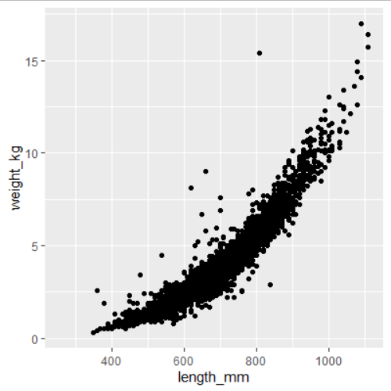
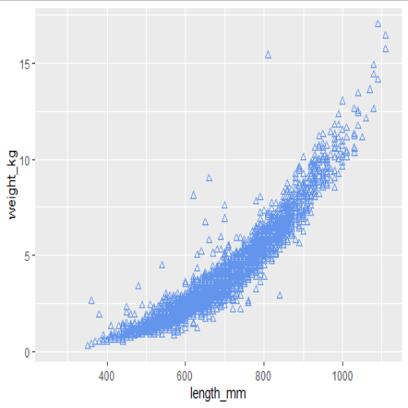
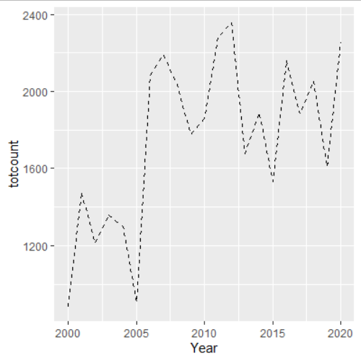
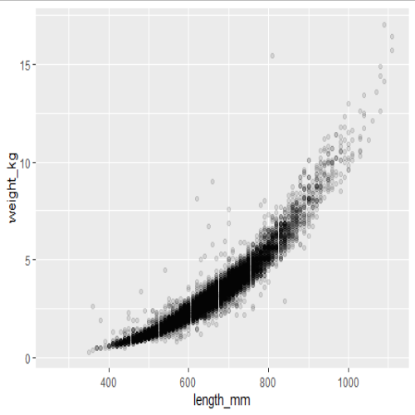

ggplot parts: geoms
To modify this plot, common arguments within a geom are:
color
shape (only for geom_point)
alpha (transparency)
linetype (only for geom_line)
ggplot(sablefish, aes(x=length_mm, y = weight_kg)) +
geom_point()
ggplot(sablefish, aes(x=length_mm, y = weight_kg)) +
geom_point(color = "cornflowerblue")
ggplot(sablefish, aes(x=length_mm, y = weight_kg)) +
geom_point(color = "cornflowerblue", shape=2)
ggplot(sablefish, aes(x=length_mm, y = weight_kg)) +
geom_point(alpha = 0.1)
ggplot(data = totalsablefish, aes(x=Year, y = totcount)) +
geom_line(linetype = 2)
Notes:
Notice that none of these are within the aes()

Slide 15
ggplot parts
So far, so good! These are the minimum parts required of a ggplot.
What if we want to clean up the plot, specify colors, or change axis labels, etc.?
Now we’ll learn about adding more parts
Add lines together with a “+”

Slide 16
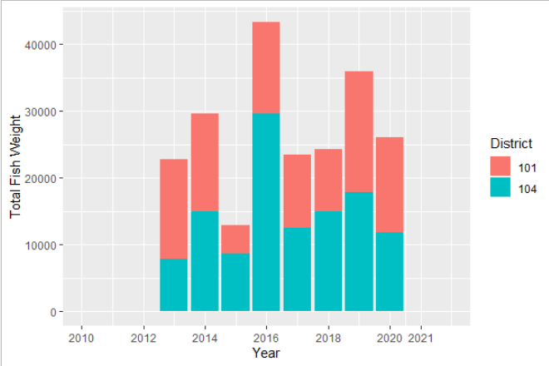
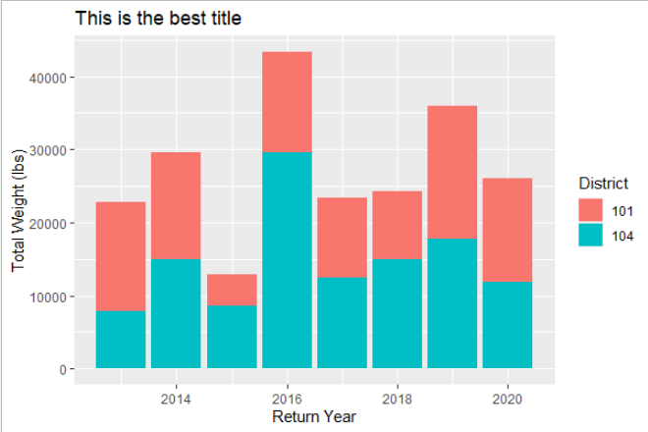
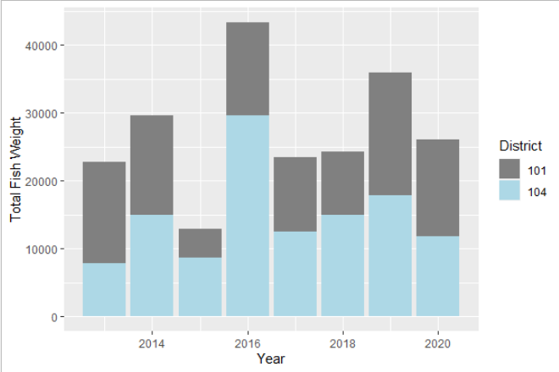
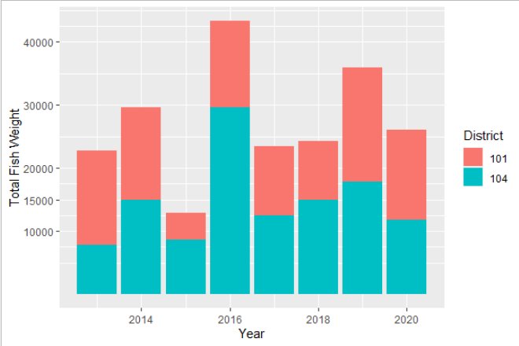

ggplot parts: scales
The scale_ family are helper functions to control aspects such as specifying color, fill, axis range / breaks, etc
Far too many to review
To change axis labels or title, use labs()
labs(x = "Return Year", y = "Total Weight (lbs)", title = "This is the best title")
expand_limits(x = c(2010, 2022)) +
scale_x_continuous(breaks = c(2010, 2012, 2014, 2016, 2018, 2020, 2021))
No modified scales
scale_y_continuous(breaks = c(10000, 15000, 20000, 30000, 40000))
scale_fill_manual(values = c("#808080", "lightblue"))
Notes:
There are too many types of scales to list.

Slide 17
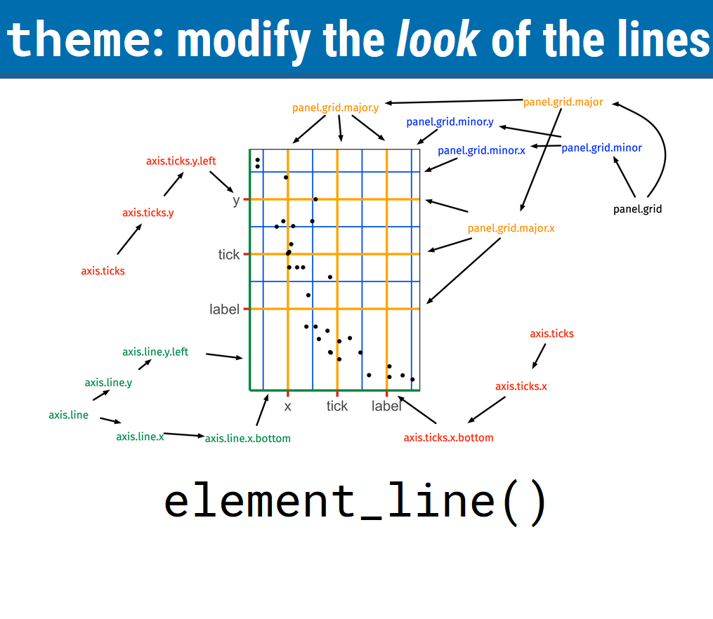
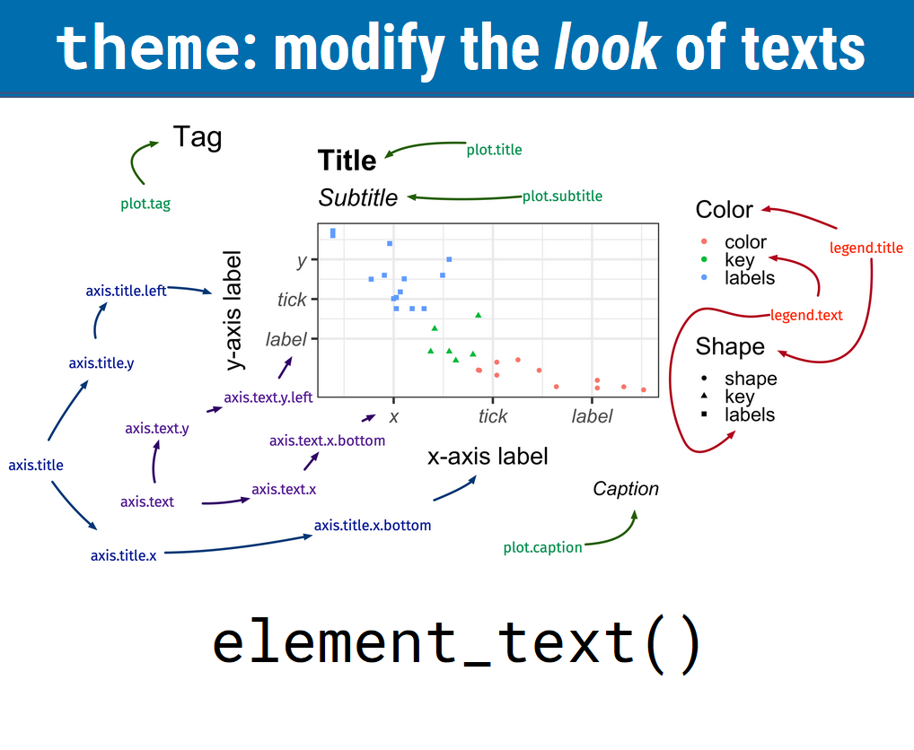
ggplot parts: theme
If you want to modify the appearance of text, axis lines, legend, etc., use theme()
There are several built in themes
theme_bw()
theme_minimal()
theme_classic()
theme_light()
I never remember how to do most theme modifications and google it
Source: https://cwd.numbat.space/lectures/lecture-06.html

Slide 18
ggplot parts: theme
Some common theme() changes:
Rotate x axis text
Increase font size & change font
Move legend position & remove legend title
theme(axis.text.x = element_text( angle = 45, vjust=1, hjust=1)
library(extrafont)
theme(base_size = 12, base_family = “Arial”)
theme(legend.position=c(0.5, 0.05), legend.title = element_blank())

Slide 19
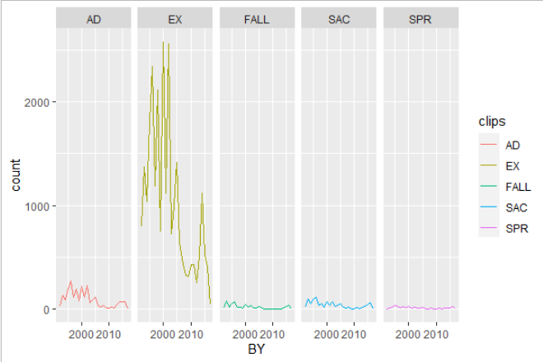
ggplot parts: Facets
One amazing feature of ggplot is the ability to create a different plot for specific subsets of a variable
Use command facet_wrap(~variable) or facet_grid(~variable)
You could even facet it based on two variables:
facet_wrap(variable1 ~ variable2)

Slide 20
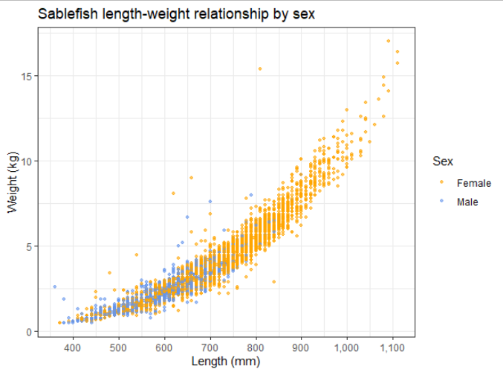
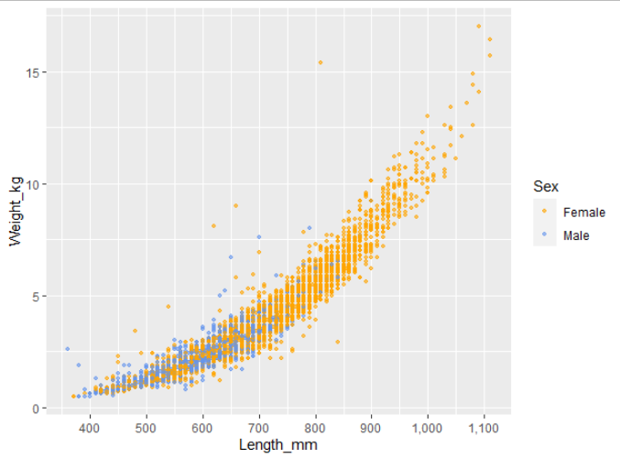
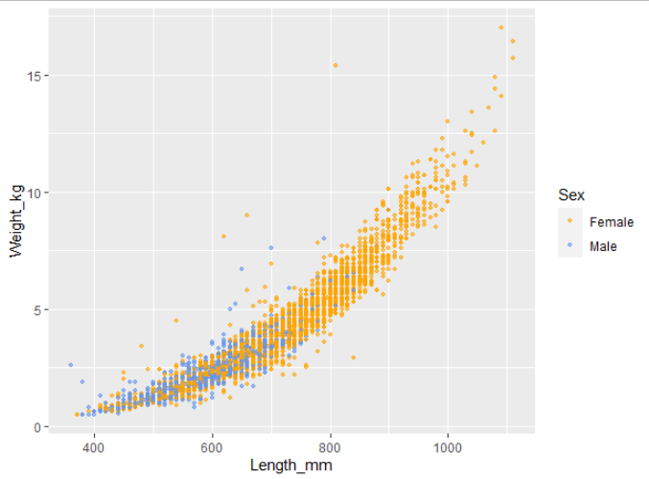
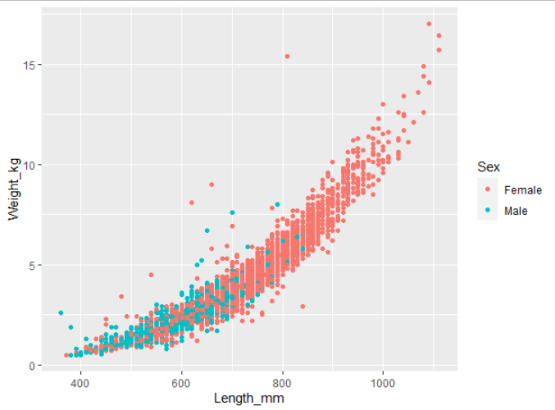

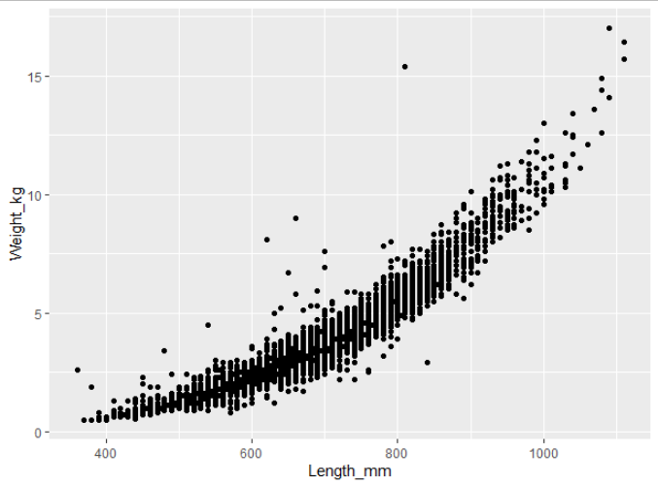
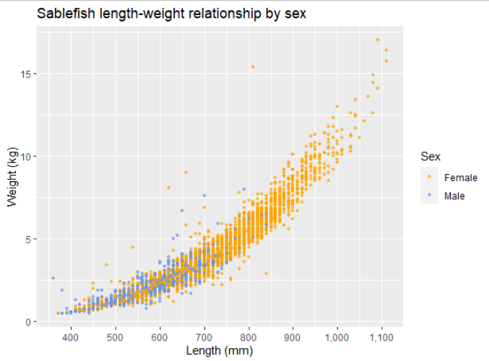
Anatomy of a ggplot
> ggplot(data = sablefish, aes(x = Length_mm, y = Weight_kg)) +
geom_point()
> ggplot(data = sablefish,
aes(x = Length_mm,
y = Weight_kg,
color = Sex)) +
geom_point(size = 0.9, alpha = 0.6) +
scale_color_manual(values =
c("orange", "cornflowerblue")) +
scale_x_continuous(breaks = c(400,
500, 600, 700, 800, 900, 1000,
1100, 1200), labels = scales::comma) +
labs(x = "Length (mm)", y = "Weight(kg)",
title = "Sablefish length-weight
relationship by sex")
> ggplot(data = sablefish,
aes(x = Length_mm,
y = Weight_kg,
color = Sex)) +
geom_point(size = 0.9, alpha = 0.6) +
scale_color_manual(values =
c("orange", "cornflowerblue")) +
scale_x_continuous(breaks = c(400,
500, 600, 700, 800, 900, 1000,
1100, 1200), labels = scales::comma) +
labs(x = "Length (mm)", y = "Weight(kg)",
title = "Sablefish length-weight
relationship by sex") +
theme_bw()
> ggplot(data = sablefish,
aes(x = Length_mm,
y = Weight_kg,
color = Sex)) +
geom_point(size = 0.9, alpha = 0.6) +
scale_color_manual(values =
c("orange", "cornflowerblue")) +
scale_x_continuous(breaks = c(400,
500, 600, 700, 800, 900, 1000,
1100, 1200), labels = scales::comma)
> ggplot(data = sablefish,
aes(x = Length_mm,
y = Weight_kg,
color = Sex)) +
geom_point(size = 0.9, alpha = 0.6) +
scale_color_manual(values =
c("orange", "cornflowerblue"))
> ggplot(data = sablefish,
aes(x = Length_mm,
y = Weight_kg,
color = Sex)) +
geom_point()
> ggplot(data = sablefish,
aes(x = Length_mm,
y = Weight_kg,
color = Sex)) +
geom_point(size = 0.9, alpha = 0.6)
Notes:
Predict what next plot will be!

Slide 21
Plotting Approach
When starting out, it’s tempting to paste a lot of code from a previous figure or something you found online.
If you can, try not to do this. A better approach is to build it step by step, line by line.
Add just the skeleton, e.g., ggplot(aes()) + geom_line(), and build out
This will immediately identify where errors exist

Slide 22
Fill vs Color
Remember to keep in mind the difference between “fill” and “color”
“Fill” fills in an area (bar column)
“Color” is the point or line
If specifying manually, these take different commands depending on discrete vs continuous data

Slide 23
Fill vs color
 | Color | Fill
Continuous | scale_color_gradientn(colors = c()) | scale_fill_gradientn(colors = c())
Categorical | scale_color_manual(values = c(“xxx”)) | scale_fill_manual(values = c(“xxxx”))
Example Code:
scale_color_gradientn(colors = terrain.colors(10))
scale_fill_gradientn(colors = terrain.colors(10))
scale_color_manual(values = c("orange", "cornflowerblue"))
scale_fill_manual(values = c("orange", "cornflowerblue"))

Slide 24
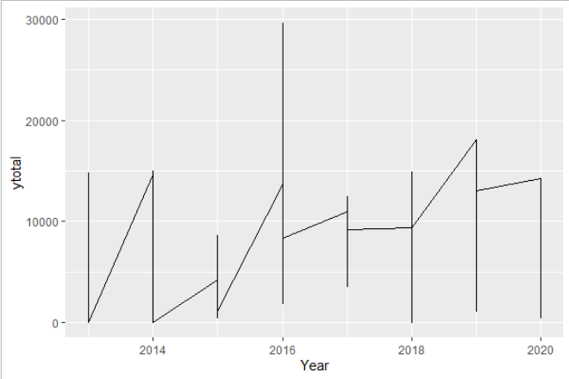
Common ggplot errors
The most common errors I see are:
What goes inside vs outside aes()
Items inside aes() are variables (changeable), outside are static
Jagged lines
You have multiple y points for each x point. Add a “group = variable2” to plot a line for each group
Color vs Fill
Easy mistake, remember the difference
Overwriting a theme
ggplot will use the last theme settings you gave it

Slide 25
Let’s practice
In RStudio, we’ll run through the script
Towards the end, let’s make it a little bit free-form. If you have a question about how to modify the plot, challenge me.
If you need another explanation later, Dr. Lendway’s videos are great!
Intro to ggplot() – 8 min
Common ggplot mistakes – 3 min
ggplot demo – 32 min
These videos support material on her learning website

Slide 26
6 – Basic Analysis
Because using 30-year-old Excel macros is so yesterday

Slide 27
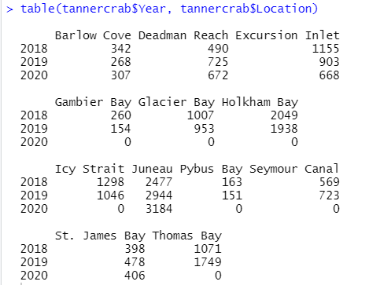
table() and summary()
These two functions quickly summarize your data
table() makes a 1x1 or 1x2 summary table of all your counts by variable
table(variable1, variable2)
summary() is a quartile distribution of your continuous data

Slide 28
group_by()
group_by() %>% summarize()
Together, these are like a pivot table
group_by() can be used to produce grouped calculations in mutate()
Very fast and useful way to view data summaries
> dataframename %>%
group_by(Year) %>%
summarize(newname =
mean(variable1))
Output:
For each year, what is the mean of variable1?
(New column is named “newname” here)

Slide 29
ANOVA
ANOVAs test whether categorical variables have different continuous distributions. For example:
Is mean length significantly different between species?
Different mean weights between years?
Use aov() and NOT anova()
Remember that there are some items to be aware of for an ANOVA (type I, II, & III). More ANOVA info here
The Anova() function from package “car” allows specifying type!
Notes:
It is very quick and easy to produce an ANOVA in R

Slide 30
T tests
t.test()

Slide 31
Linear Modeling
Modeling a linear trend in R is EASY!
lm(response ~ independentvar, data =df)
Save this output or wrap in summary()
Multiple variables are easy too:
lm(response ~ var1 + var2, data =df)
R notation:
lm(y ~ var1)
=
Formula notation:
y = β₀ + β₁var1
lm(y ~ var1 + var2)
y = β₀ + β₁var1 + β₂var2
Notes:
Your response, independent variable 1, and independent variable 2 will all be in different columns

Slide 32
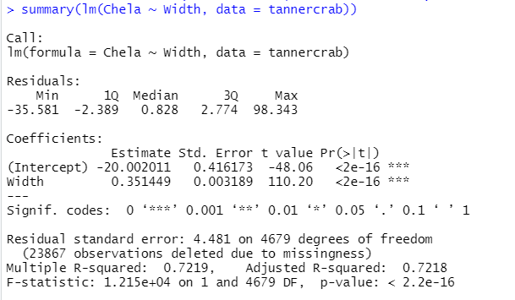
Reading lm() output
Formula
Residual diagnostics
Estimate = β₀ , β₁
Std. Error & t value
Pr(>|t|) = p-value
R²

Slide 33
Binomial
glm() binomial

Slide 34
7 - Tidyverse
It’s like R, but different. And better. Definitely better.

Slide 35

What is the Tidyverse
The Tidyverse is a collection of packages that extend the usefulness of R, use slightly different language syntax, and play well together
Some of the most common Tidyverse packages are:
dplyr – data manipulation (mutate, select, filter, summarise)
ggplot2 – produce beautiful charts
tidyr – change data layout to one observation per row, and inverse
tibble – use “advanced” data frames
readr – fast and friendly way to read in data
lubridate – work with dates
And several others!
Loaded with
library(tidyverse)
Notes:
We previously used some of these earlier: dplyr is amazing for data manipulation and ggplot2 is amazing for plotting

Slide 36
Why Should You Use the Tidyverse?
It’s often simpler to read: filter(Year == 2010)
Forces cleaner data which will save you time later
Makes certain data types workable (e.g., dates)
More powerful features
Constantly updated (future of R?)
Downside
Syntax is different and you’ll know two different ways to do same thing

Slide 37

dplyr
Already learned about most of these functions
Introduces the “pipe” operator %>%
Add a new column using mutate(), choose specific rows based on column values using filter(), change whether a column is included using select(), change column names using rename()
**warning** you may find code online that uses the previous version of this package called “plyr”. If you find a function that uses plyr, I highly recommend not using it if you use “dplyr”. The two packages can (rarely) have major issues with each other.
Notes:
We’ve covered most of these previously because they’re so useful!

Slide 38
dplyr
join functions add two datasets together based on some common columns
Most often, I use left_join()
Notes:
We’ve covered most of these previously because they’re so useful!

Slide 39
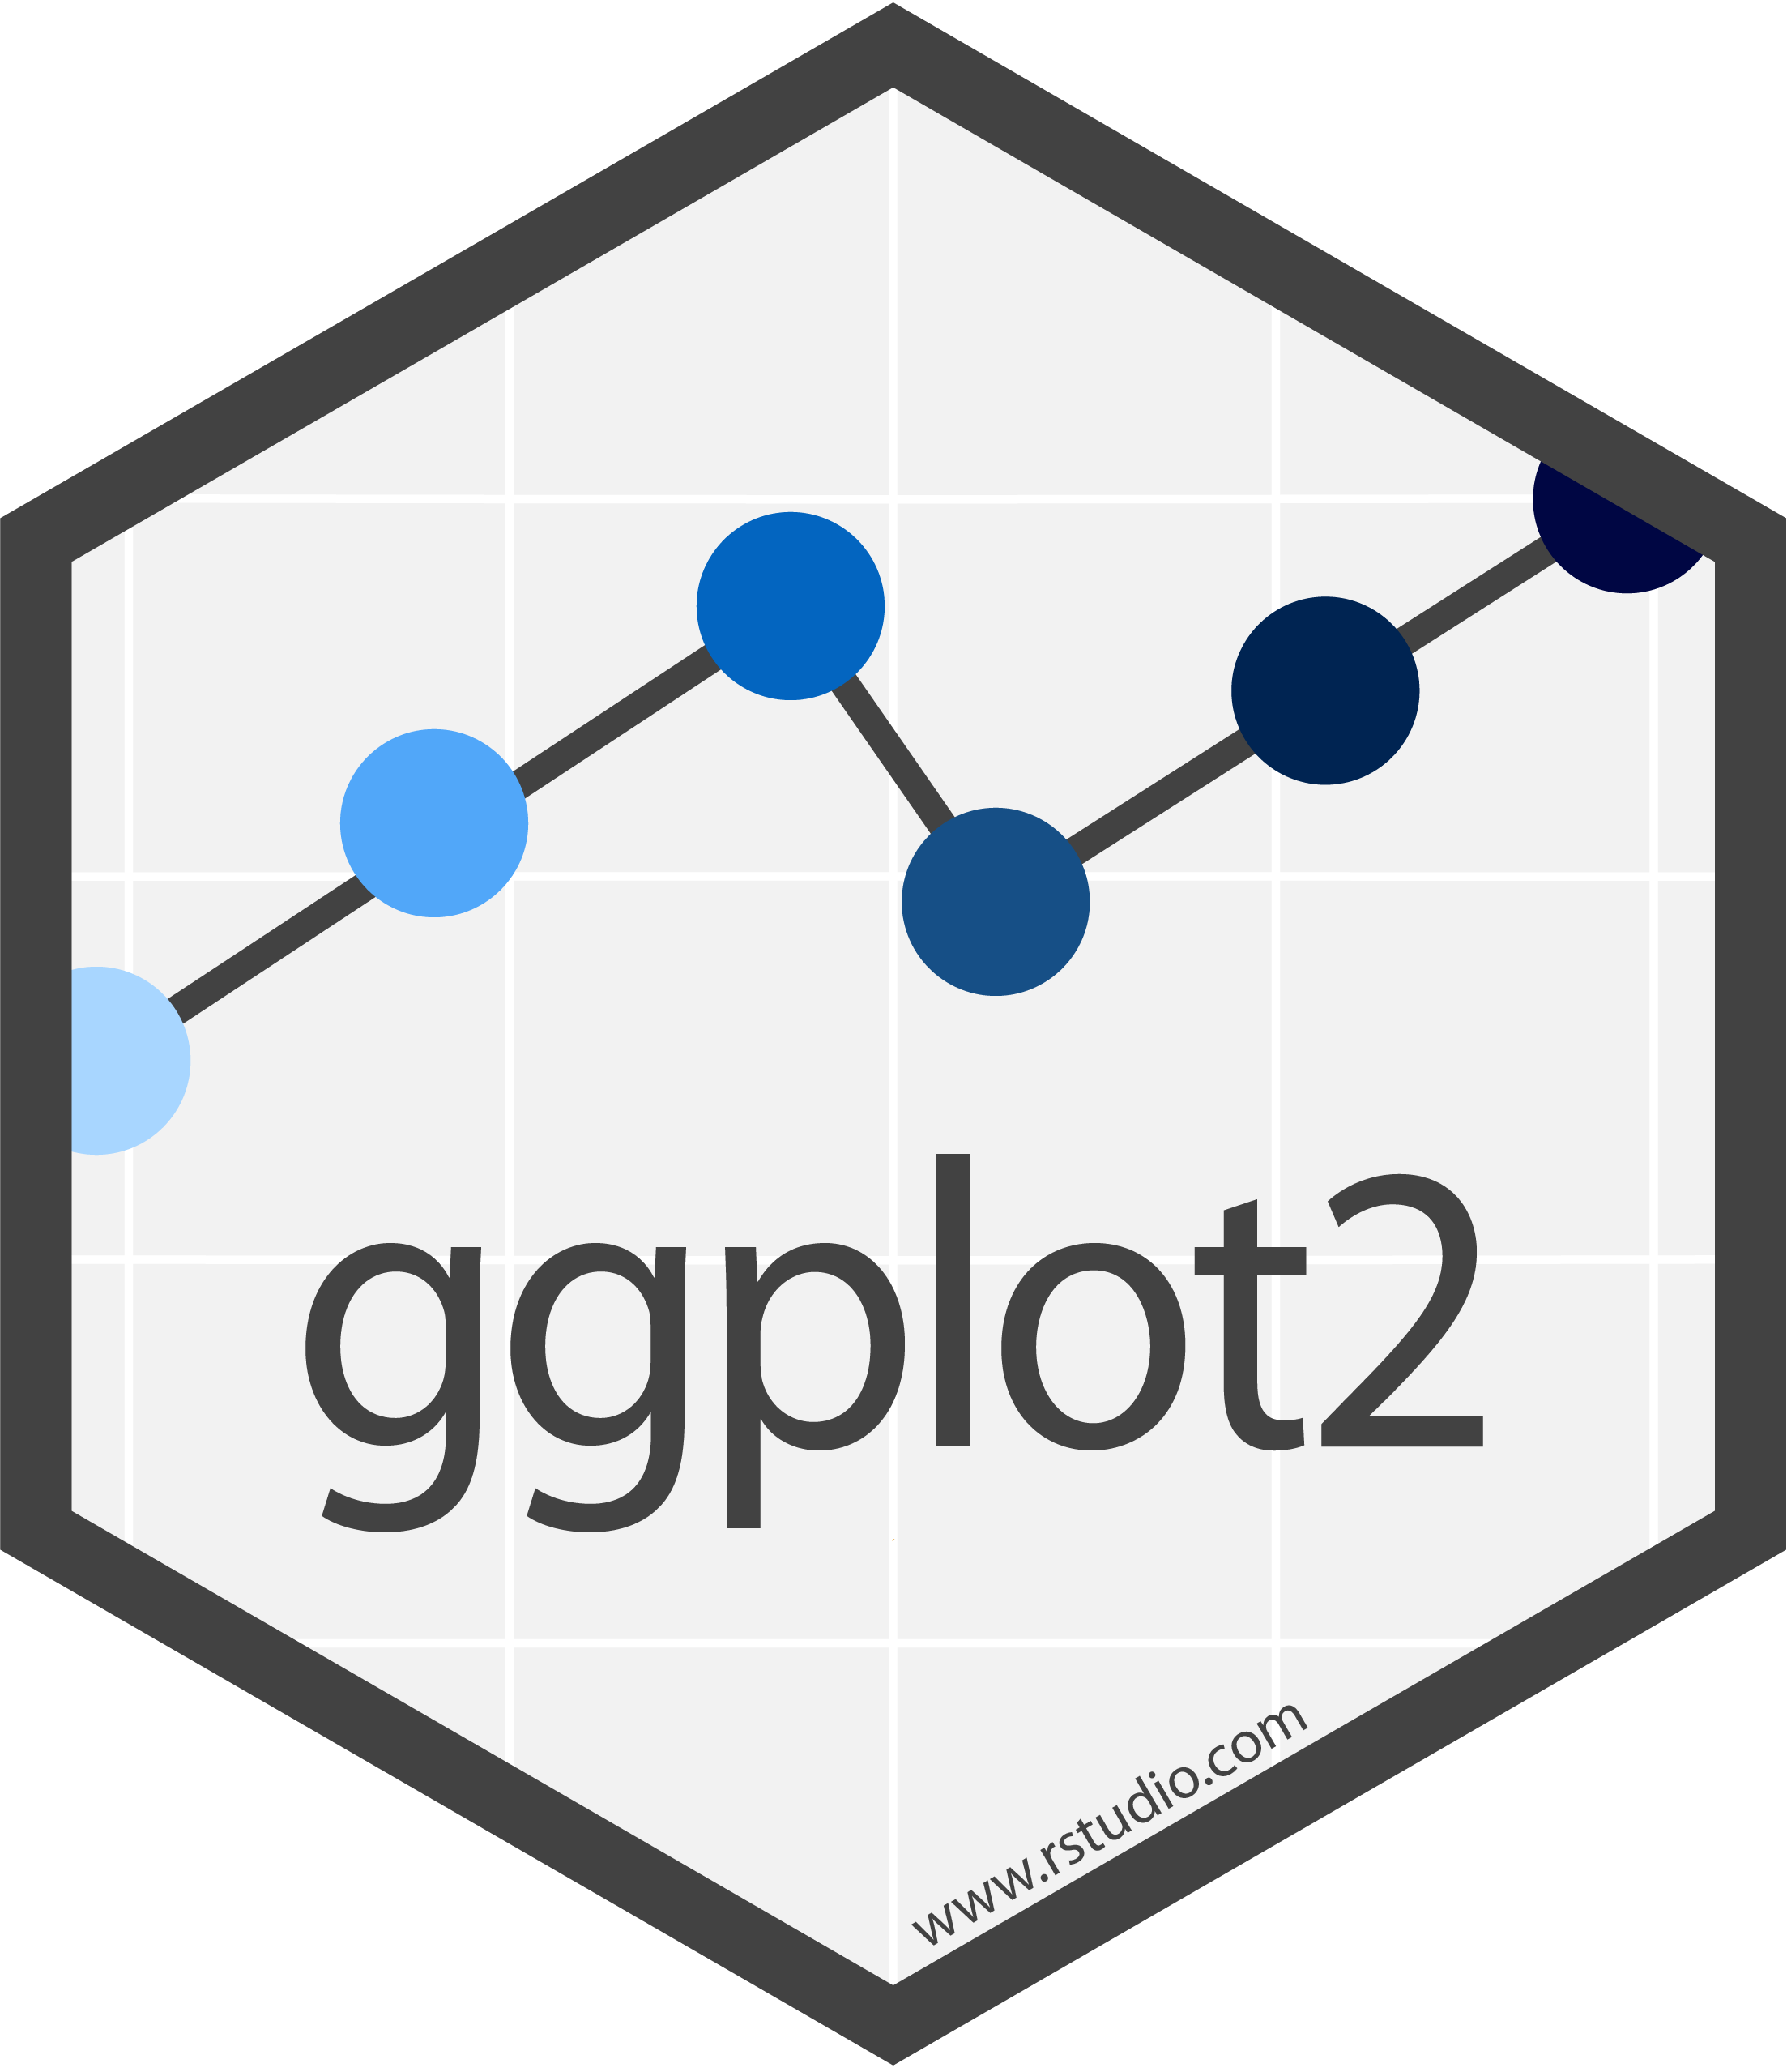
ggplot2
The most popular way to plot in R
Uses a “grammar of graphics” which takes a bit to learn
The basic structure is defining the source dataframe, the aesthetics (variables for x axis (& y axis), variables for color/shape, etc), and then a call to what type of plot you’re making (points, lines, histogram, etc)
Strings together commands using “+” between the lines
Notes:
Also covered previously

Slide 40

lubridate
Dates are probably the most difficult thing to deal with when starting out in R.
lubridate provides a better interface; can easily convert between date formats, subtract time periods, calc day of year, etc.
For “11/12/12”, what is the month? Are you sure?
Excel is great at dealing with dates but it isn’t perfect either

Slide 41
lubridate examples
Example 1: Convert “11/12/2020” to a date (12 Nov 2020)
Answer 1:
mutate(newdate = ymd(as.POSIXct(olddate, format = "%m/%d/%Y", tz = "US/Alaska"))
Example 2: Convert “2020-12-31” to a date (31 Dec 2020)
Answer 2:
mutate(newdate = ymd(as.POSIXct(olddate, format = "%Y-%m-%d", tz = "US/Alaska"))
This is the format of the existing data NOT the format you want it in
Notes:
Use the code here as a template for your future code

Slide 42
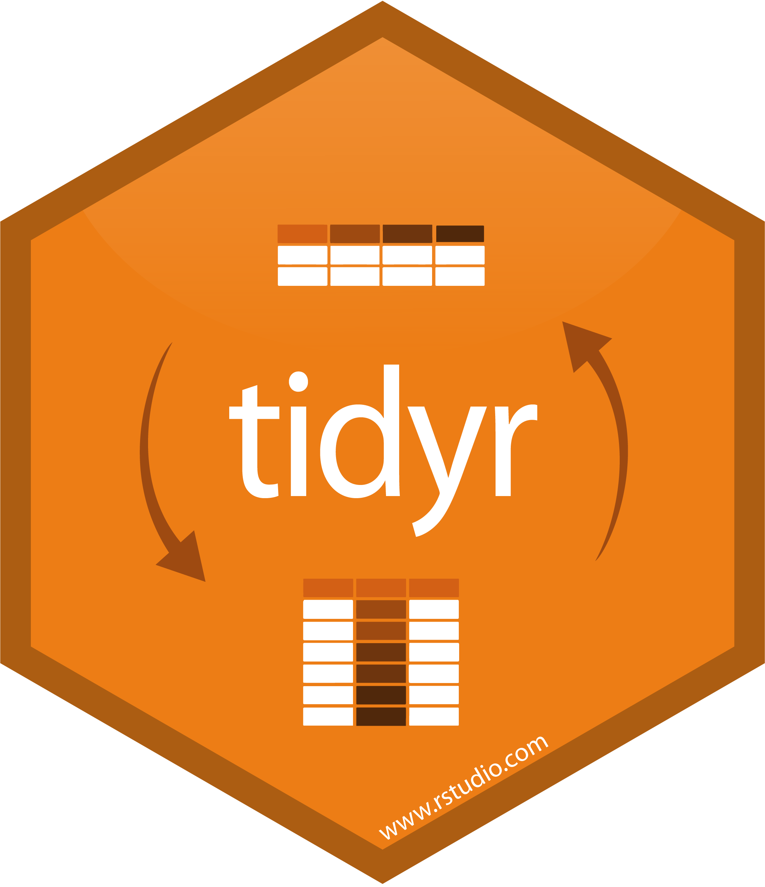
tidyr
tidyr is a package whose main functions help to turn “wide” data into “long” data and vice-versa
pivot_wider() and pivot_longer()
These two easily turn data from wide to long (pivot_longer) or from long to wide (pivot_wider)
When possible, keep data in long format
Allows you to model / plot easier

Slide 43
tidyr example
Pivot longer example code

Slide 44
Creating a new RProject

Slide 45
Motivating Example

Slide 46
Project
Use a provided dataset (or bring your own) to create a visualization

Slide 47
Project Goal
When we come back from lunch, create and save a script that does the following:
Imports your dataset or one of the provided CSV files
Loads needed libraries
Filters to a specific subset of data (optional)
Using ggplot, visualize some aspect of the data
Email me your plot and script file!
Remember! It’s OK to Google how to do something. I do it for EVERY script

Slide 48
Project Steps
Choose a dataset
Open in Excel to look at data
Create a new directory/project & copy over all needed files (not required but helpful if you want to use this later)
Create & save a blank script file
Import data into R
Perform needed data manipulation
View data, decide what to visualize
Plot in ggplot (and troubleshoot along way)
If you finish early, you can:
Message & help others
Make more plots
Google other “touch ups”
Do some simple analysis / summaries
If you feel like you’re not making progress that’s fine! Message me or a peer ☺

Slide 49
Examples
Some example projects that you could do are:
Tanner crab chela width vs crab width
Pink salmon
You are welcome (and expected) to copy code over that we’ve done together. Read error statements closely. Google your problems.
If you want to pair up and work on the same dataset, it’s great to talk it out and share code! However, write as much individually as you can: the more you write, the more the ideas are cemented

Slide 50
Lunch Break
See you all at 1 PM

Slide 51
Work on Projects
Good luck! I’ll try to help as many people as possible during this time
Start simple, work up to complicated.
Send me some of your plots by email / chat!

Slide 52
Project Steps
Choose a dataset
Open in Excel to look at data
Create a new directory/project & copy over all needed files (not required but helpful if you want to use this later)
Create & save a blank script file
Import data into R
Perform needed data manipulation
View data, decide what to visualize
Plot in ggplot (and troubleshoot along way)

Slide 53
Chart Presentation & Concluding Thoughts
Present plots
Some miscellaneous best practices and ways to have a smoother R experience

Slide 54
Plots

Slide 55


Workflow
When starting out, it’s common to manipulate your data in Excel, save this file, then import/analyze in R
There is nothing wrong with this and if it works for you, great!
It’s MUCH better though to do all this in R
Documents what you did
Saves steps for cleanup that is performed each time

Slide 56
Best Practices
R is not that great for tables but is excellent for figures
Don’t use spaces in filenames or directories if you can
Name files descriptively
Don’t overwrite previous files but rename them clearly
Use easy to understand variable names
Break up your data import / cleanup & analysis scripts
Use several scripts that “link” together rather than one long one
Comment often and be VERY thorough, I promise that you’ll experience frustration at yourself for not being clearer
“Always comment your code as if the person who reviews your code will be a violent psychopath who knows where you live”
Surprise!
It’s going to be you…

Slide 57
Best Practices, cont.
Update your R version and all packages often
Unless you’re about to publish and need absolutely nothing to change
Follow people on GitHub / Twitter to read other people’s code and learn better coding practices
Read in data using .csv files (unless already in relational DB), never use file.choose(), never use the “Import Dataset” wizard in RStudio. Keep file paths relative and not static
Use “Projects” in Rstudio to keep scripts organized

Slide 58
Relative Paths
If the first line of your R script is
setwd("C:\Users\jenny\path\that\only\I\have")
I will come into your office and SET YOUR COMPUTER ON FIRE
If the first line of your R script is
rm(list = ls())
I will come into your office and SET YOUR COMPUTER ON FIRE
- Jenny Bryan

Slide 59
Relative Paths cont.
Why is this a bad idea?
If you will be the only person to ever run this code and you will absolutely, never change computers, it’s fine to keep it this way.
The solution: Use relative paths and RStudio projects

Slide 60



Not Covered
So many things weren’t covered but some of the more interesting are:
GitHub – Can sync your files to the internet which makes life MUCH simpler, especially if you are collaborating. Highly recommended
Rmarkdown – Create PDF, HTML, Word etc. files embedded with your R script outputs. Allows automatic report creations.
Shiny – This package allows for the creation of interactive apps
Spatial Analysis – Unique enough analyses to warrant its own discipline. If you can do it with ArcGIS, you can probably do it with R

Slide 61
Parting Thoughts
Like any language, becoming familiar with R requires a little practice over a long period of time. It’s easy to get discouraged initially.
Keep googling your problems: it’s very unlikely that you’re the first with this issue. I still google how to do something almost every other line of code.
Programming is not the same as asking the right questions: learn more statistics! It is possible that you are attempting analysis that is best accomplished differently. Or worse, doing something you shouldn’t.
Notes:
For me, the best way to motivate myself to learn was having my own dataset to work through; for others, online tutorials were best.
Even the best programmers still google and read Stack Exchange.

Slide 62

Congrats!
This certificate is good for a free R help session, one-on-one!
Plus, you’re always welcome to ask me for help; the worst I can say is I’m busy
Notes:
I really enjoy helping people with their R questions. Please message me

Slide 63
Resources
Just Starting Out
https://cran.r-project.org/doc/manuals/R-intro.pdf
https://cran.r-project.org/doc/contrib/Paradis-rdebuts_en.pdf
https://r-bootcamp.netlify.app/
https://rstudio.cloud/learn/primers
https://ggplot-dplyr-intro.netlify.app/
long but comprehensive

Slide 64
Resources
Data Management
Data Organization in Spreadsheets
https://annebeaudreau.com/2018/02/04/data-management-tips/
Workflow
https://whattheyforgot.org/project-oriented-workflow.html
https://www.tidyverse.org/articles/2017/12/workflow-vs-script/

Slide 65
Resources
Style Guides
http://r-pkgs.had.co.nz/style.html
https://google.github.io/styleguide/Rguide.xml
Statistics
http://www.shinystats.org/
https://seeing-theory.brown.edu/regression-analysis/index.html

Slide 66
Cheatsheets
All cheatsheets
Getting started
dplyr and tidyr
Data import
lubridate
ggplot2
RStudio

Slide 67
Special Thanks
People who have taught me or whose code I have shamelessly copied and learned from:
Franz Mueter (UAF)
All UAF classmates
Ben Williams (NOAA/ADF&G)
Jordan Watson (NOAA)
Curry Cunningham (UAF/NOAA)
Jenny Bryan (UBC)
Hadley Wickham (RStudio)
Greg Wilson (RStudio)
Allison Horst (RStudio)

